Slide 1
CONTRIBUTIONS
NAME | CONTRIBUTION
Abhimalya Chaudhary | Task 2: Provided a solution to this problem statement by ranking the documents based on their relevance scores for each task using BM25Okapi ranking algorithm •Extracted answer-excerpts from each of these ranked documents for each task using BERT pre-tained models.
Abhishek P.M | Task 1: LDA For Topic Modeling to obtain Related Documents (Task 1 Deliverable 1) Improvised LDA Using KMeans, PCA And T-SNE for better clustering of Documents. Search Engine For Queries Using Glove and TF-IDF ( T1 Deliverable 2) PowerPoint Presentation and Notebook Documentation
Aditya Girigoudar | Task 1: Implemented Semantic Search using Word Embedding. Improved Semantic Search Model to give results based on user-defined queries and limit the number query results required by the user. Explored the theory and implemented basic LDA Model to know its working.
Amogh Shetty | Literature Survey and Report

Slide 2
TITLE CODE: 5DMACP18
TITLE: COVID 19 OPEN RESEARCH DATASET
TEAM NO: 5A12 SEM: 5 DIV: A
Team Members:
NAME
USN
ROLL NO
Abhimalya Chaudhary
Abhishek P.M
Aditya Girigoudar
Amogh Shetty
01FE18BCS007
01FE18BCS010
01FE18BCS017
01FE18BCS035
107
110
117
135

Slide 3
TASKS SELECTED FROM THE RESEARCH CHALLENGE
TASK 1: What do we know about diagnostics and surveillance?
Development of a point-of-care test (like a rapid influenza test) and rapid bedside tests, recognizing the tradeoffs between speed, accessibility, and accuracy.
Technology roadmap for diagnostics.
Enhance capabilities for rapid sequencing and bioinformatics to target regions of the genome that will allow specificity for a particular variant.
Coupling genomics and diagnostic testing on a large scale.
TASK 2: Create summary tables that address diagnostics for COVID-19
Development of a point-of-care test and rapid bedside tests
Diagnosing SARS-COV-2 with Nucleic-acid based tech
Diagnosing SARS-COV-2 with antibodies
How does viral load relate to disease presentations and likelihood of a positive diagnostic test?

Slide 4
DELIVERABLES OF THE PARTICULAR TASKS
TASK 1: What do we know about diagnostics and surveillance?
Given a New Document, List the Documents that also are similar to the Given Document
Given a Query, Create a Search Engine to retrieve papers about the query and Rank them based on their Similarity Score
TASK 2: Create summary tables that address diagnostics for COVID-19
Given a Query, Create a Summary Table to Address the Particular Query

Slide 5
PREPROCESSING OF THE DATASET
Convert To Dataframe Extracting Relevant Information
Drop Duplicate Paper Id and Abstract
JSON DATA
1,18,947 Files
JSON DATAFRAME
1,18,947 Entries
Attributes: 3
JSON DATAFRAME
Attributes: 3
Paper_ID, Abstract, Full Text Extracted
Replace Nan’s and Drop Duplicate Abstracts
Integrating Metadata with Json using inner join on SHA
DATAFRAME
63,108 Entries
Attributes: 7
DATAFRAME
70,209 Entries
Attributes: 7
Final
Dataframe
JSON DATAFRAME
Attributes: 3
To Obtain Body Text of Papers
DATAFRAME: 63,108 Entries
Attributes: Paper_id, doi, abstract, publish_time,title,authors,full_text

Slide 6
PREPROCESSING OF THE DATASET
Considering Only Papers which are published in ‘2020’
Removing Papers From Different
Languages
DATAFRAME
63,108 Entries
Attributes: 7
DATAFRAME
30,324 Entries
Attributes: 7
DATAFRAME
29,546 Entries
Attributes: 7
30,324 Entries
29,546 Entries
Removing Common and Custom Stop Words
DATAFRAME
10,000 Entries
Attributes: 8
Final Data Frame obtained
DATAFRAME
29,546 Entries
Attributes: 8
DATAFRAME
29,546 Entries
Attributes: 8
10,000 Entries Considered With Random State Applied
Merge Title, Abstract and Text and clean the Text data using Regular Expression and store in new column
To Obtain Completely clean processed Text
DATAFRAME: 10,000 Entries
Attributes: Paper_id, doi, abstract, publish_time,title,authors,full_text,Processed_text

Slide 7
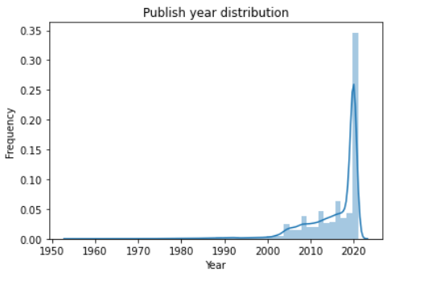
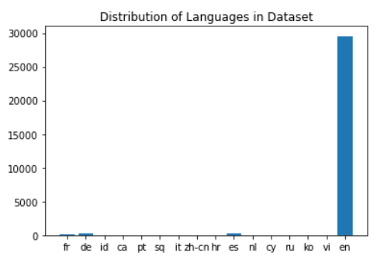
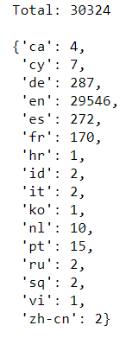
ILLUSTRATIONS OF PREPROCESSING OF THE DATASET
Plot For the Number of Papers that are published during a particular Year
Plot For the Number of Papers that are published in a particular language and the count of Each.

Slide 8
APPROACH 1: SEMANTIC SEARCH USING WORD EMBEDDINGS
In this method we will use gensim Word2Vec in order to generate word embeddings using the abstract texts as our corpus. For each document, we calculate the centroid of its abstract and for each query word, we map it to a vector then calculate the word centroid similarity for the query and each document's abstract. The top ranked papers are shown as results.
Gensim Word2Vec corpus should be in the form of separate sentences
DATAFRAME
10,000 Entries
Attributes: 8
Word2Vec Training
sentence tokenization.
Sentence Tokenization
Training the gensim Word2Vec model with our own custom corpus.
Calculating the centroid for each abstract using the vectors of all the words incorporating the abstract.
Results
Ranking the Documents
Word Centroid Similarity (WCS)
Paper Name and Paper Link plus Results of User-defined queries.
Ranking the documents based on the similarities.

Slide 9
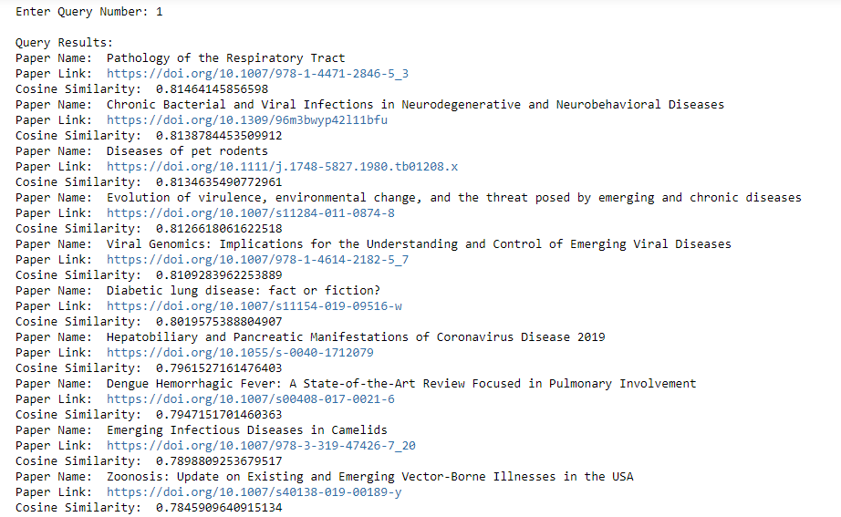
Results: How widespread current exposure is to be able to make immediate policy recommendations on mitigation measures. Denominators for testing and a mechanism for rapidly sharing that information, including demographics, to the extent possible. Sampling methods to determine asymptomatic disease

Slide 10
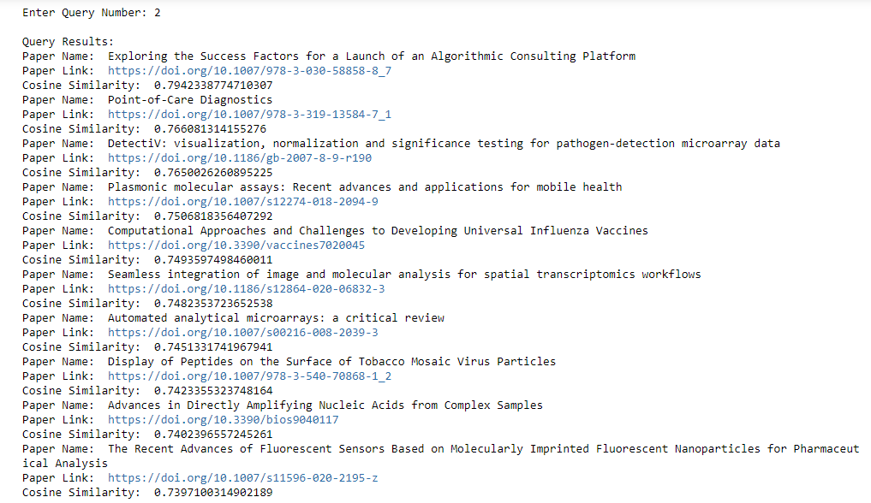
Results: Efforts to increase capacity on existing diagnostic platforms and tap into existing surveillance platforms.

Slide 11
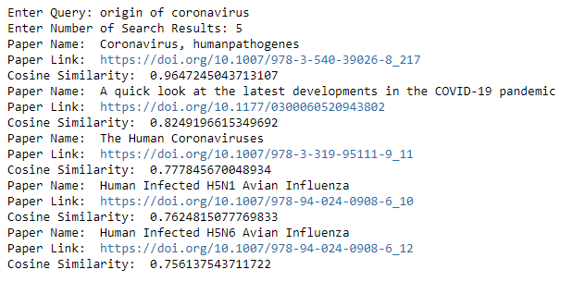
User-defined Queries:

Slide 12
APPROACH 2: IMPLEMENTING LATENT DIRICHLET ALLOCATION (LDA)
FOR DELIVERABLE 1 OF TASK 1
Attribute ‘Processed Text’ is the Key Feature. Tokens are made for all the sentences
Dictionary is created by filtering extremes based on frequency
DATAFRAME
10,000 Entries
Attributes: 8
BIGRAM MODEL WITH TOKENS
Term Document Frequency Corpus
Bigrams are obtained from the created Tokens
Corpus is Obtained
Applying LDA To find Dominant Words Belonging To a Topic
Number of Topics are Hyperparameter
Dominant Words in Each Topic Are Obtained
Final Model To Obtain Documents
Document Topic frame
Taking Tokens from query and finding similarity with word list of Topics To retrieve documents of that Topic
Best Fit LDA Model is obtained and the topics in each document is matched
We are using two variants of LDA: LDA BOW and LDA TF-IDF. We are generating multiple LDA models with different number of topics as a main hyper-parameter to then choose the best model based on the coherence and perplexity scores

Slide 13
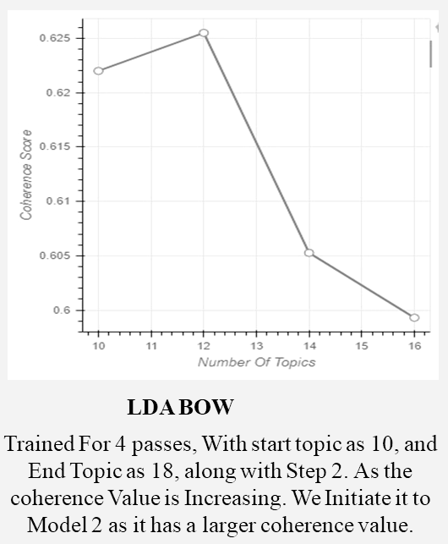
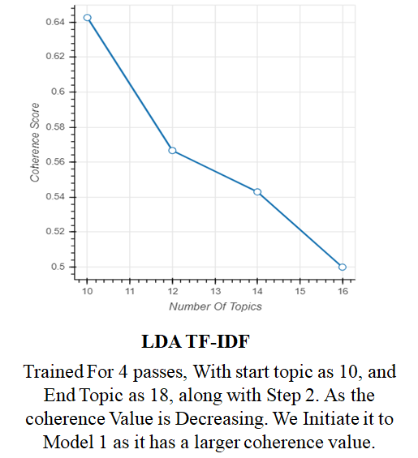
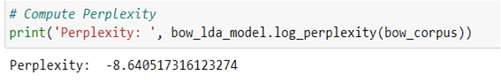
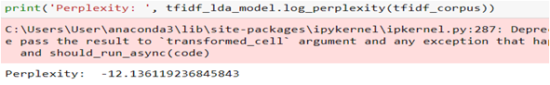
ILLUSTRATIONS OF APPROACH 1

Slide 14
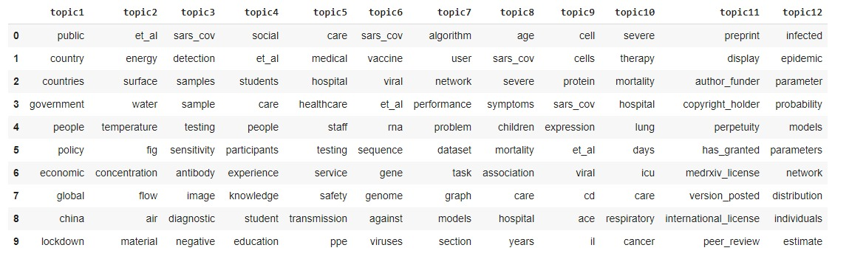
OBTAINED WORD TO TOPIC ASSIGNMENT FOR THE LDA MODEL

Slide 15
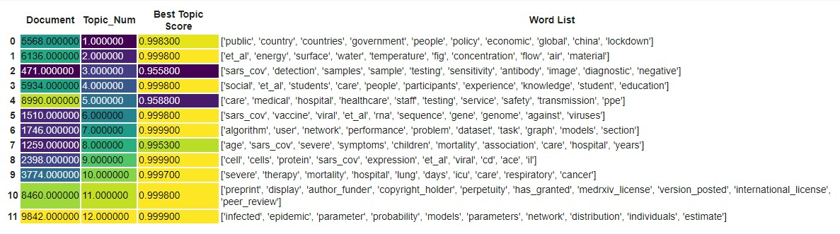
OBTAINED TOPIC TO DOCUMENT ASSIGNMENT FOR THE LDA MODEL
DOCUMENTS WITH HIGH SIMILARITY SCORES TO THE OBTAINED TOPICS

Slide 16
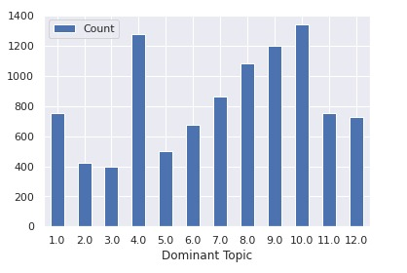
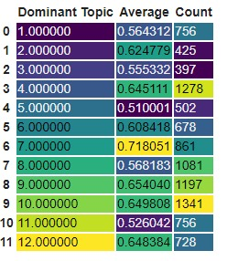
ANALYTICS ON DOCUMENT TO TOPICS ASSIGNMENT
GRAPH PORTRAYING COUNT OF DOCUMENTS PER TOPIC
AVERAGE PAPERS PER TOPIC AND THE COUNT OF PAPERS

Slide 17
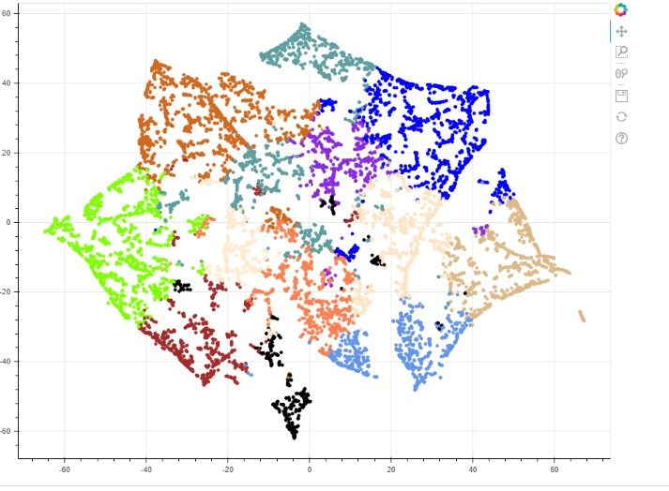
T-SNE BASED CLUSTERING THROUGH DOCUMENT-TOPIC RELATION

Slide 18
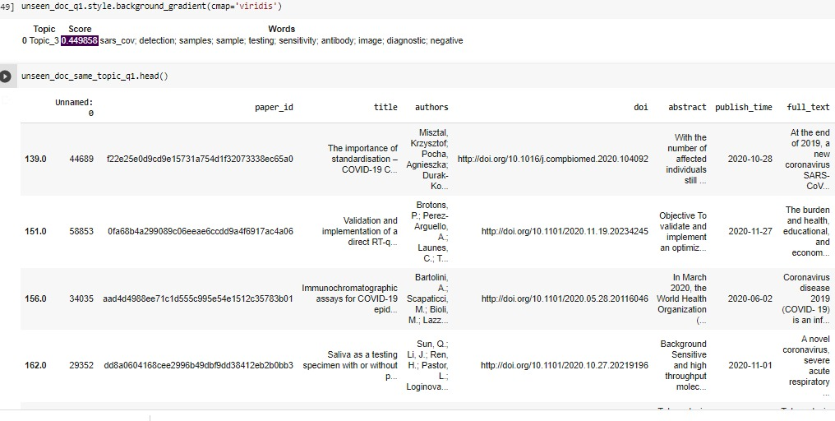
RESULTS OF LDA BASED MODELLING
DOCUMENT CONTENT 1: How widespread current exposure is to be able to make immediate policy recommendations on mitigation measures. Denominators for testing and a mechanism for rapidly sharing that information, including demographics, to the extent possible. Sampling methods to determine asymptomatic disease ( use of serosurveys (such as convalescent samples) and early detection of disease
WORD LIST IS TAKEN FROM THE DOCUMENT AND A TOPIC IS ASSIGNED, DOCUMENTS IN THAT TOPIC ARE LISTED

Slide 19
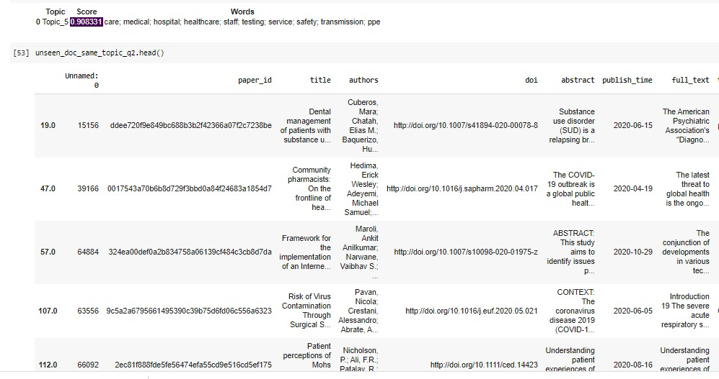
RESULTS OF LDA BASED MODELLING
DOCUMENT CONTENT 2: Efforts to increase capacity on existing diagnostic platforms and tap into existing surveillance platforms.
WORD LIST IS TAKEN FROM THE DOCUMENT AND A TOPIC IS ASSIGNED, DOCUMENTS IN THAT TOPIC ARE LISTED

Slide 20
APPROACH 3: IMPLEMENTING LDA USING K MEANS, PCA AND T-SNE
TO IMPROVISE MODEL 2 AND AN EFFORT TO FULFILL DELIVERABLES 1 AND 2 OF TASK 1
DATAFRAME
10,000 Entries
Attributes: 8
Apply tf-idf to obtain Document Feature matrix
4096 Top frequency Words as Features
Apply T-SNE To find the Documents with similarity and reduce the high dimension data
Scatter Plot in 2D With Labels
Document Feature Matrix
Scatter plot of Documents in 2 Dimension
Clustering of similar Documents and Dimension is reduced to 2D
LDA Applied Individually To each of the cluster
Applying PCA to the data trying to preserve 95% Variance
Removes Outliers and reduced to only important dimensions
Document Feature Matrix
( Reduced Dimension)
Labels (Colors) To Each Cluster
Dominant Words in Each Cluster
K means is applied to find the clusters and obtain different labels(Color) to Each Cluster

Slide 21
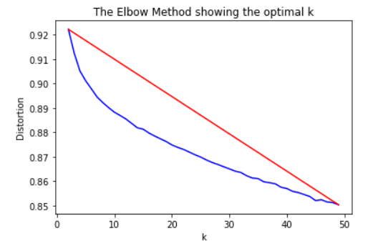
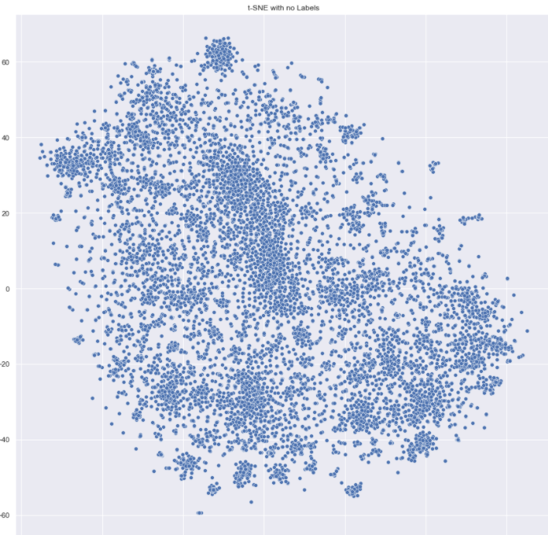
ILLUSTRATIONS OF APPROACH 2
Iterated Values for K to find the most Appropriate K value Using Elbow Method
T-SNE Plot With No Labels

Slide 22
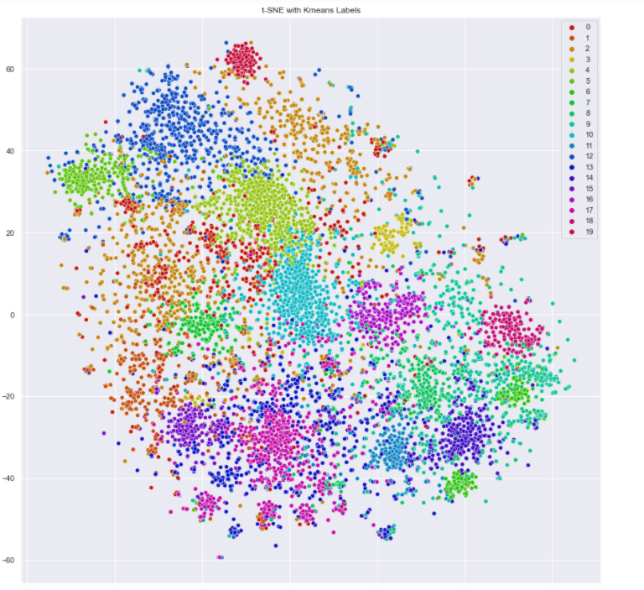
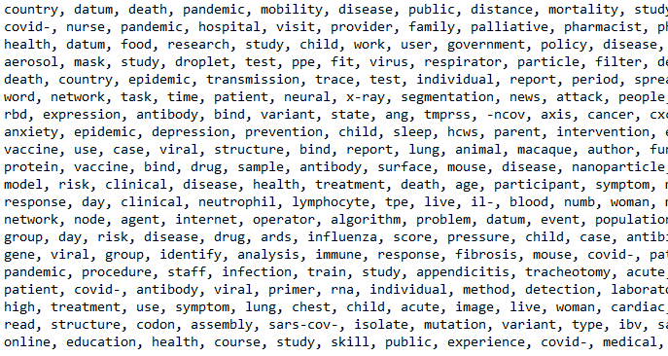
ILLUSTRATIONS OF APPROACH 2
Dominant Words in Each Cluster obtained through applying LDA on Each of the Cluster
T-SNE With K MEANS labels

Slide 23
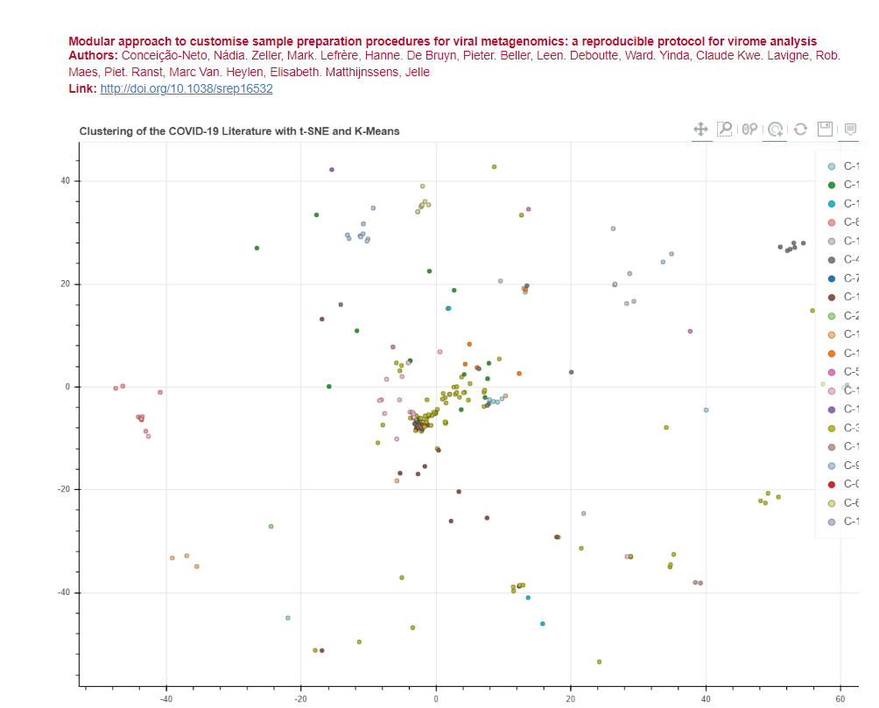
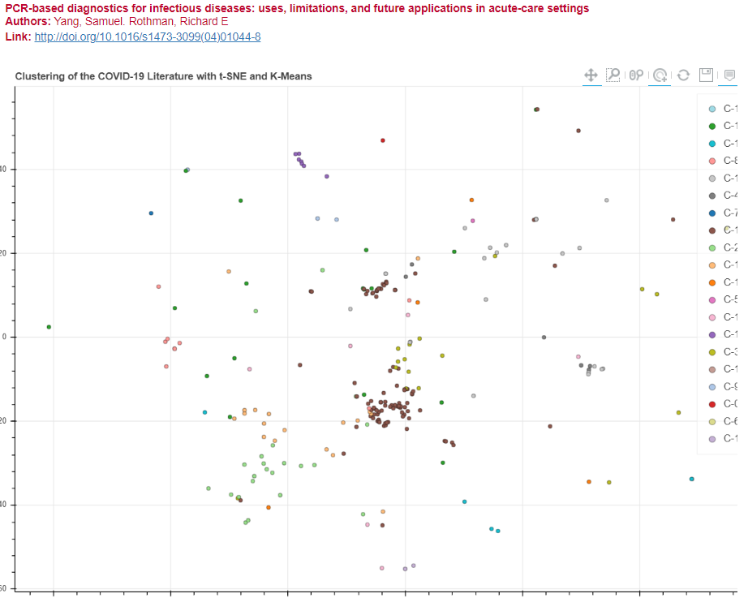
RESULTS FROM APPROACH 2
RESULTANT CLUSTER FOR SEARCH TERM ‘GENOMICS’
RESULTANT CLUSTER FOR SEARCH TERM ‘DIAGNOSTICS’

Slide 24
SEARCH ENGINE TO RETRIEVE TOP RELEVANT PAPERS
We initially perform Query expansion. Using this approach we are taking user's query and using a semantic model to add to it some similar words that might help in the search. The Semantic Model We are using is ‘GLOVE’.The expanded user query is then passed to a simple TF IDF-based search engine that computes query-to-document cosine similarity.
The Glove Model Is Initiated and Trained With Tokens From Processed Text
A Dictionary is Created to the Word Embedding
Check Graphs of Semantic Similarity Between Words
Obtain the Word Embeddings and Check for Similar words
Run For 15 Epochs To train for Semantic Similar Words
Instantiate TF-IDF For Processed Text and Queries
Top 10 Documents With High Similarity Score Retrieved
Similarity Score and Keywords Obtained
Obtain the Sparse Matrices for Processed text and Queries
Run Function To obtain Cosine Similarity Score and Keywords Responsible for Matching

Slide 25
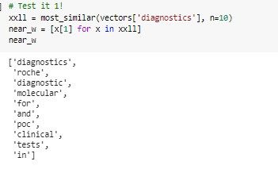
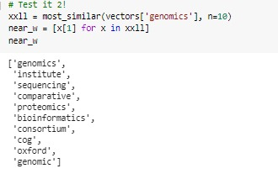
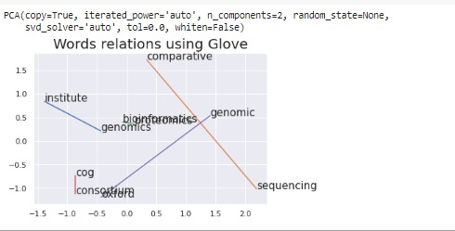
USING GLOVE TO RETRIEVE SIMILAR WORDS
Glove could helps us to identify words that often co-occur or have the same meaning but were lost in a big quantity of papers.
Plotting Semantic Similarity For Word ‘Genomes’
Semantically Similar Words To ‘Genomes’
Semantically Similar Words To ‘Diagnostics’

Slide 26
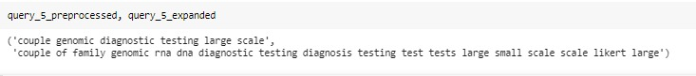
QUERY EXPANSIONS USING GLOVE

Slide 27
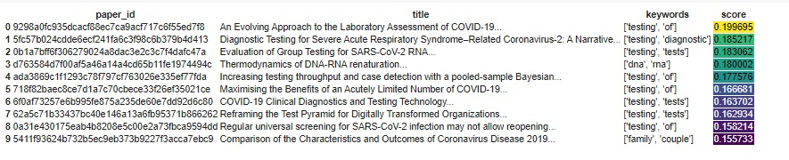
RESULTS FROM COSINE SIMILARITY AND KEYWORDS
QUERY: Couple Genomic Diagnostic Testing Large Scale

Slide 28
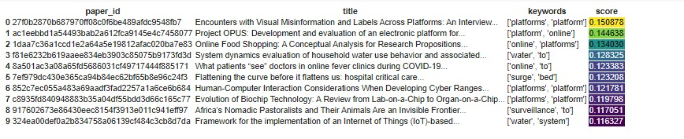
RESULTS FROM COSINE SIMILARITY AND KEYWORDS
QUERY: Efforts to Increase Capacity on existing Diagnostic Platforms and tap into existing surveillance platforms

Slide 29
TASK 2: Create summary tables that address diagnostics for COVID-19
'What do we know about diagnostics and coronavirus?’,
'New advances in diagnosing SARS-COV-2’,
'Development of a point-of-care test and rapid bed-side tests’,
'Diagnosing SARS-COV-2 with Nucleic-acid based tech’,
'Diagnosing SARS-COV-2 with antibodies’,
'How does viral load relate to disease presentations and likelihood of a positive diagnostic test?'

Slide 30
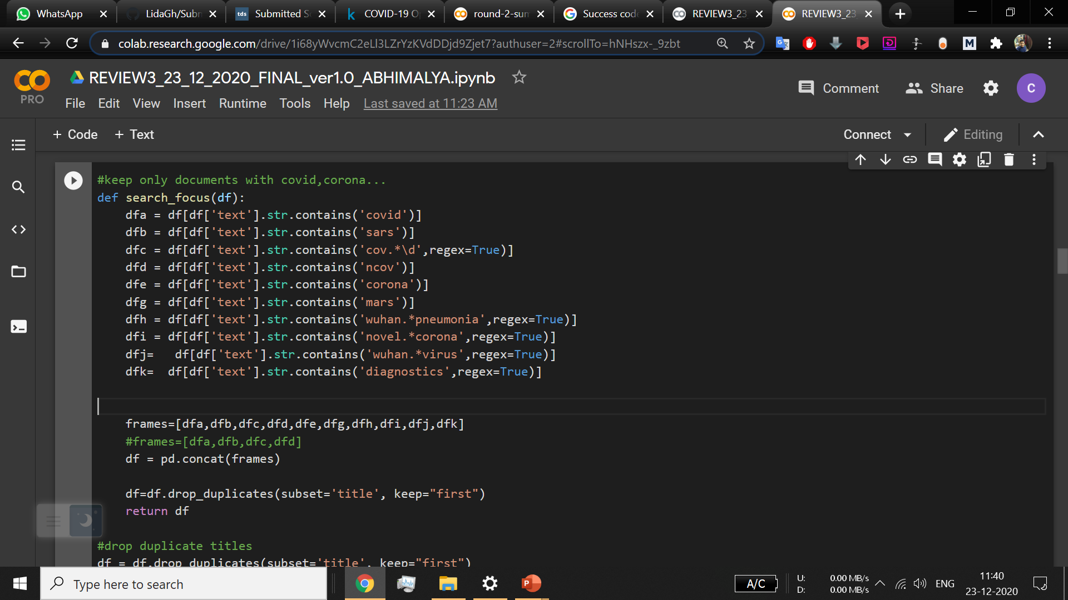
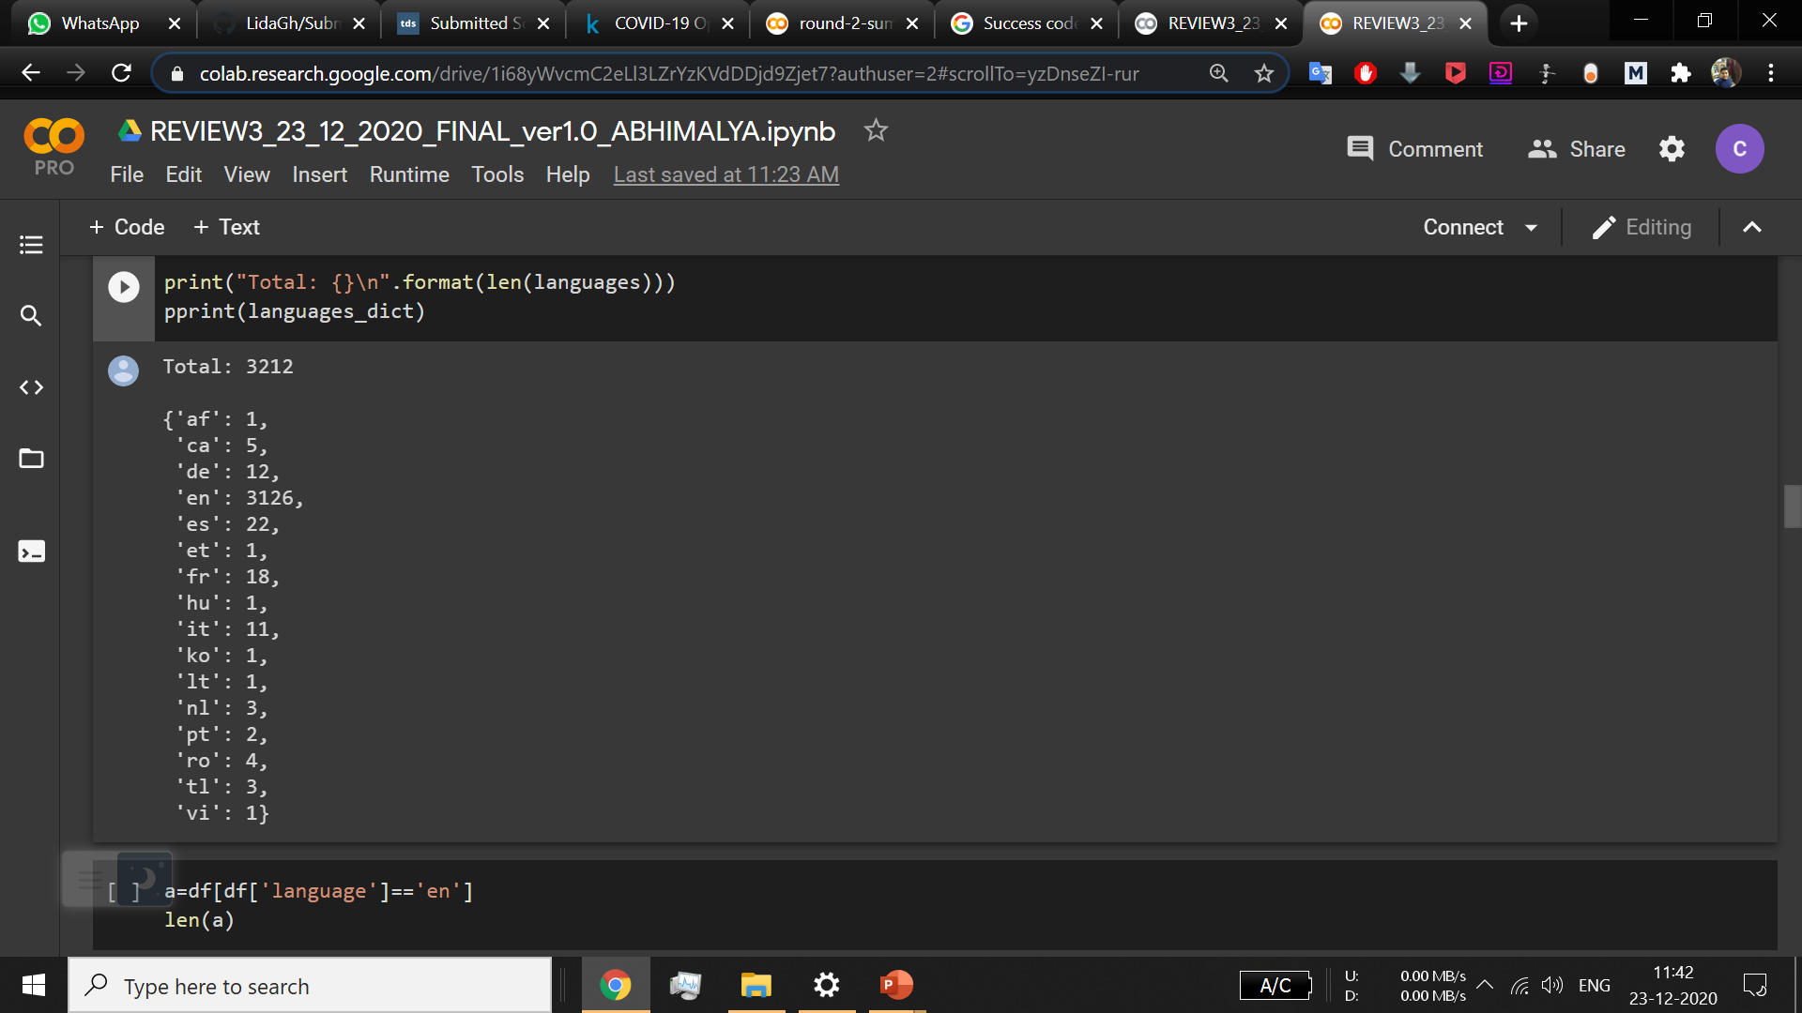
Task Specific Preprocessing
Kept only documents related to COVID-19
Kept documents which are only in English

Slide 31
Step 1: Ranking of documents using BM25 Okapi Algorithm
In information retrieval, Okapi BM25 (BM is an abbreviation of best matching) is a ranking function used by search engines to estimate the relevance of documents to a given search query. It is based on the probabilistic retrieval framework developed in the 1970s and 1980s by Stephen E. Robertson, Karen Spärck Jones, and others.
The problem that BM25 (Best Match 25) tries to solve is similar to that of TFIDF (Term Frequency, Inverse Document Frequency), that is representing our text in a vector space (it can be applied to field outside of text, but text is where it has the biggest presence) so we can search/find similar documents for a given document or query.
BM25 improves upon TFIDF by casting relevance as a probability problem. A relevance score, according to probabilistic information retrieval, ought to reflect the probability a user will consider the result relevant.

Slide 32
Workflow
In this method,we will first tokenize the entire body text for each of the documents. Also, each of the queries must be tokenized into words. The tokenized query as well as the text will be the input to our BM25Okapi algorithm
DATAFRAME
3000 Entries
Word
Tokens
word tokenization.
BM25Okapi Algorithm
Results
Ranked Documents
Paper Name and Paper Link

Slide 33
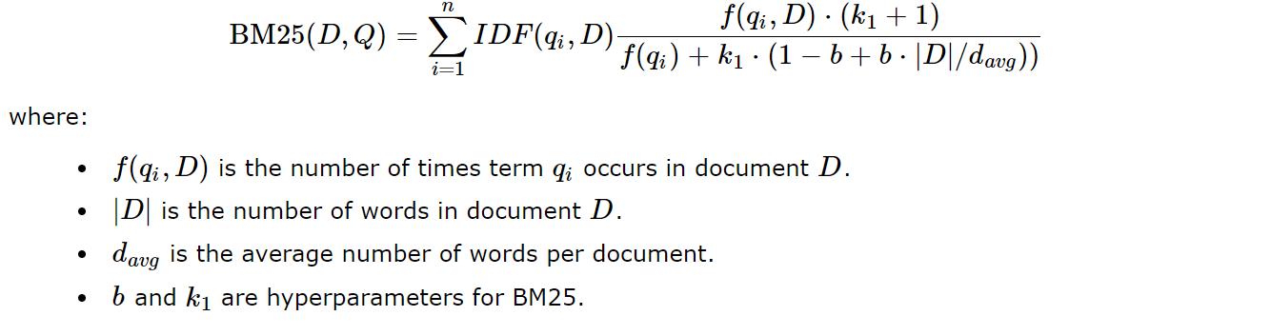
BM25 Algorithm
BM25 (Best Match 25) function scores each document in a corpus according to the document's relevance to a particular text query. For a query Q , with terms q1,…,qn , the BM25 score for document D is:

Slide 34
What-Why-How Analysis
BM25 score is a linear weighted combination of scores for each of the words that make up the query. The total score is the sum of score of each of the words in the query. Words, such as ‘in’, ‘the’, are referred to as stop-words and they appear in almost every English documents. Hence, such words contribute negligibly to the overall BM25 score, since, their IDF score comes out to be nearly zero. On the other hand, unique words such as ‘sars-cov-2’, ‘advances’ contribute highly to the BM25 score, their IDF score being high. The final score of a document is determined by summing up the scores obtained for each of the terms present in the query.
BM25 improves upon TF-IDF, a common scoring function for determining search relevance. Let us see how

Slide 35
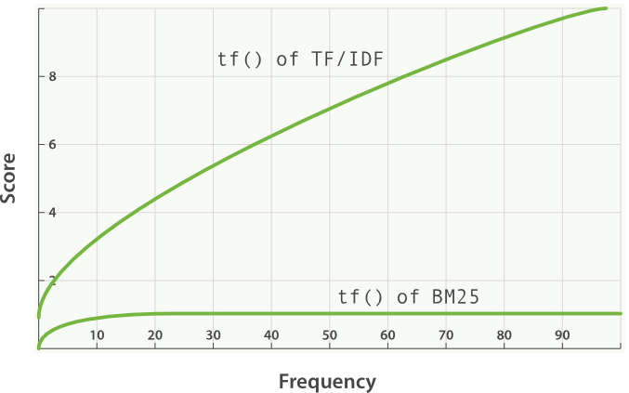
What-Why-How analysis (Contd.)
The IDF component of BM25 scoring function measures how often a term occurs in all of the documents and “penalizes” terms that are common.
Plot to show tf() score of TF-IDF and BM-25 vs the frequency of words

Slide 36
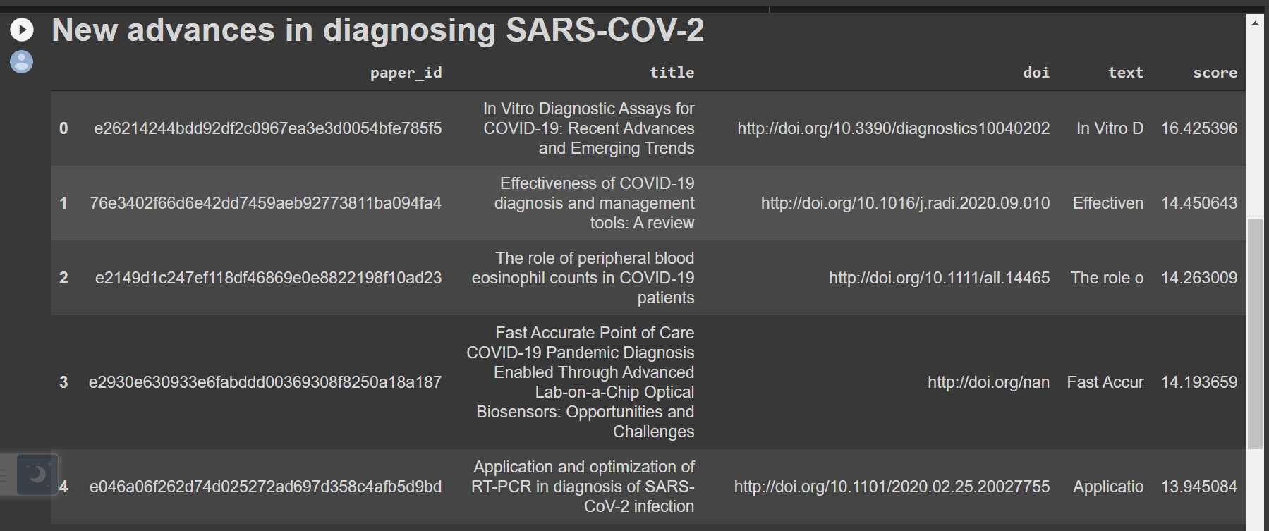
Results
Documents are displayed in descending order of the scores obtained

Slide 37
Step 2: Creating summary from each of the ranked documents
For creating summary, we have extracted the relevant answer-excerpts for each of the queries from the ranked documents.
For this purpose, we have used the BertForQuestionAnswering class from the transformers library.
We have used a number of models from this class, including “bert-large-uncased-whole-word-masking-finetuned-squad”, “bert-base-uncased”,” bert-base-cased”,” bert-large-cased”,” bert-base-cased-finetuned-mrpc”
Workflow:
We begin the task by computing the input_ids by encoding the question and the paragraph text.
We find the tokens from the question and the paragraph text
Then we calculate the segment_ids which seperates the question from the paragraph text
We feed the input_ids and segment_ids to the model to calculate the start and end scores
Finally, we find the answer by indexing the tokens between the highest start and end scores

Slide 38
What-Why-How analysis
BERT - a state-of-the-art model for a range of various problems in natural language processing was developed by Google and published in 2018 and is for example used as a part of Googles search engine. The term BERT is an acronym for the term Bidirectional Encoder Representations from Transformers.
BERT outperforms various other methods because it is the first unsupervised, deeply bidirectional system for pre-training NLP.
BERT was built upon recent work in pre-training contextual representations — including Semi-supervised Sequence Learning, Generative Pre-Training, ELMo, and ULMFit — but crucially these models are all unidirectional or shallowly bidirectional. This means that each word is only contextualized using the words to its left (or right). BERT represents each word using both its left and right context, starting from the very bottom of a deep neural network, so it is deeply bidirectional.
BERT uses a simple approach for this: We mask out 15% of the words in the input, run the entire sequence through a deep bidirectional Transformer encoder, and then predict only the masked words. For example:
Input: the man went to the [MASK1] . he bought a [MASK2] of milk.
Labels: [MASK1] = store; [MASK2] = gallon

Slide 39
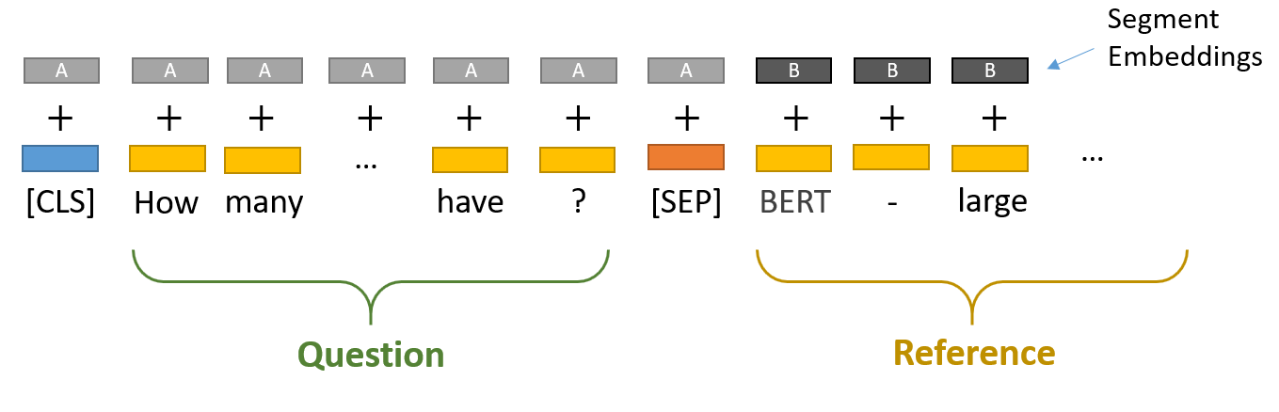
Input Format
For the Question Answering task, BERT takes the input question and passage as a single packed sequence. The input embeddings are the sum of the token embeddings and the segment embeddings. The input is processed in the following way before entering the model:
Token embeddings: A [CLS] token is added to the input word tokens at the beginning of the question and a [SEP] token is inserted at the end of both the question and the paragraph.
Segment embeddings: A marker indicating segment A or segment B is added to each token. This allows the model to distinguish between segments.

Slide 40
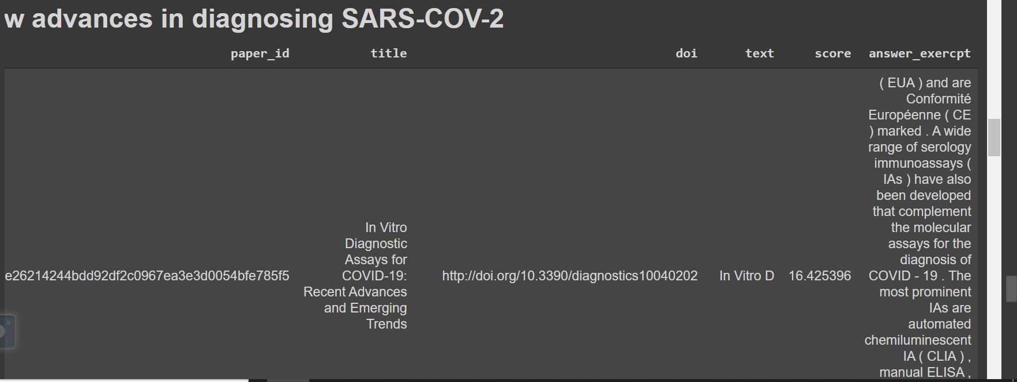
Results

Slide 41
Thank you

